Slide 1

PUMIEZ - A SLIDE PUZZLE
Developers: Eyal Wolanowski,
Yoni Zilberman
Academic supervision: Dr. Hanan Gazit

Slide 2
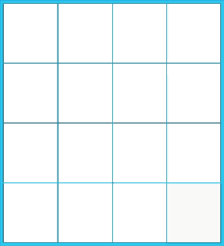















THE ESSENCE OF THE PROBLEM
Developing a thinking game which improves cognitive abilities using gamification mechanism as the incentive to continue playing the game

Slide 3

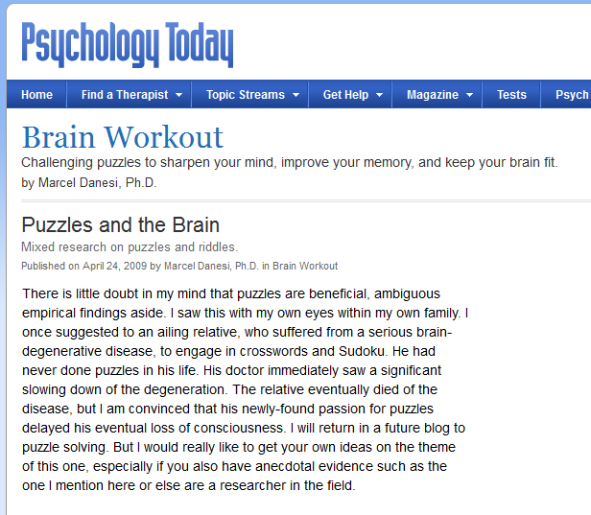

THE NEED FOR MORE THEN JUST A GAME
Games are fun and helps us enhance our abilities and improve our skills

Slide 4
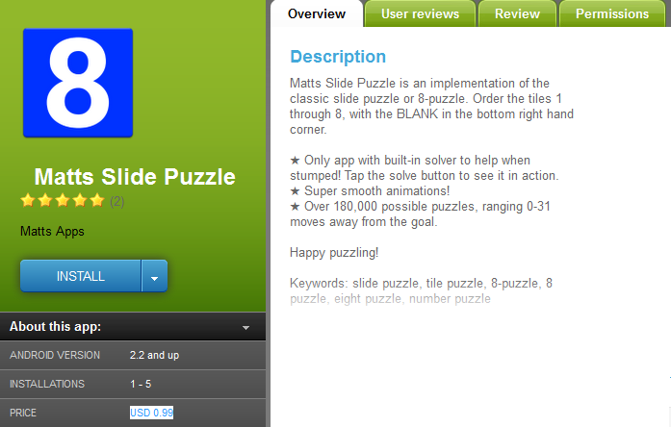
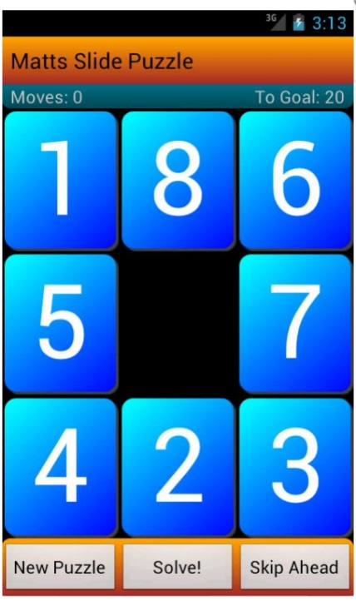
MARKET REVIEW
Adding complexity, customization,
fun and user interaction

Slide 5

GOALS
A working game
Optimized solution for 8/15 slide puzzles
Create fun and challenge
Have social aspect

Slide 6
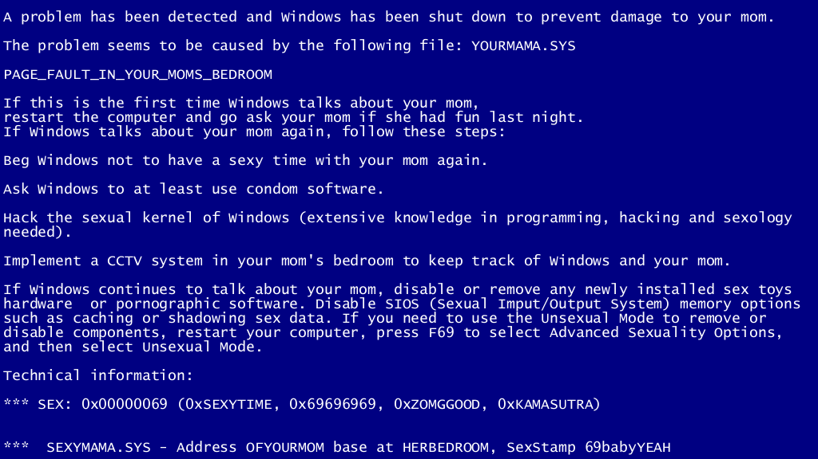
CHALLENGES
Mathematical and algorithmic
Components integrations
Developers knowledge
UI

Slide 7
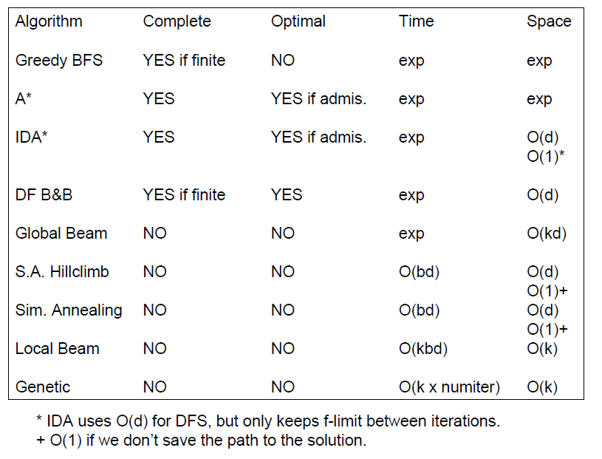

CHOOSING THE RIGHT ALGORITHM

Slide 8

TECHNOLOGY
PHP
JAVA
PHP/JAVA Bridge
HTML5/CSS
JavaScript
MySQL

Slide 9
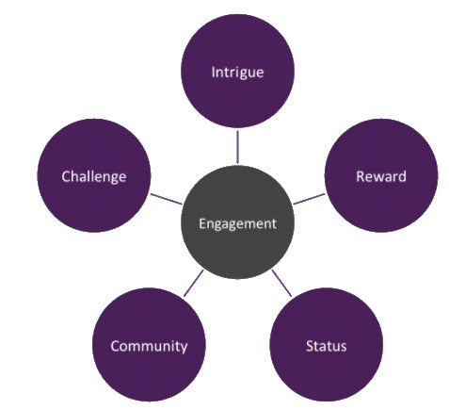

GAMIFICATION AS THE INCENTIVE

Slide 10
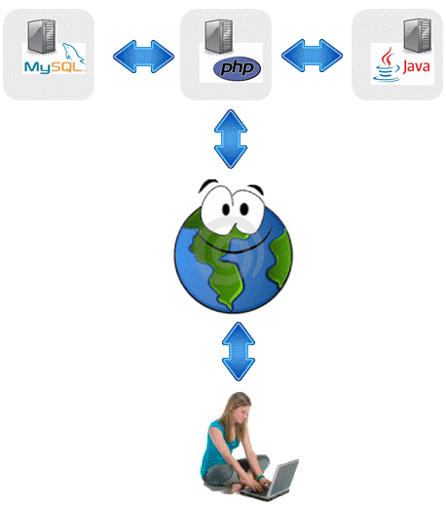
ARCHITECTURE
User profile
and achievements
Images storage
UI storage
IDA* calculation

Slide 11
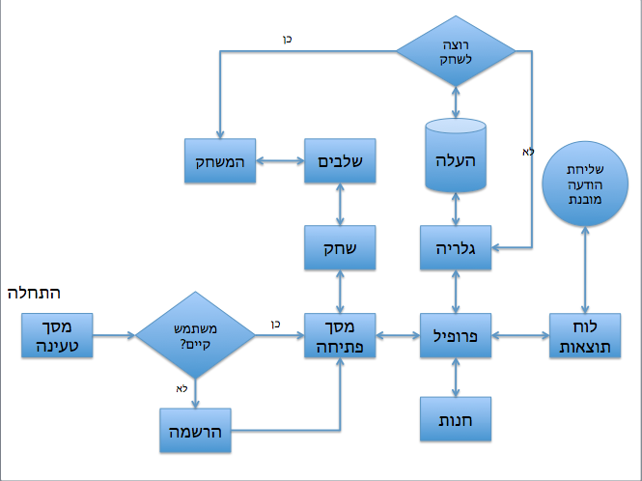
ARCHITECTURE

Slide 12

DEMONSTRATION

Slide 13
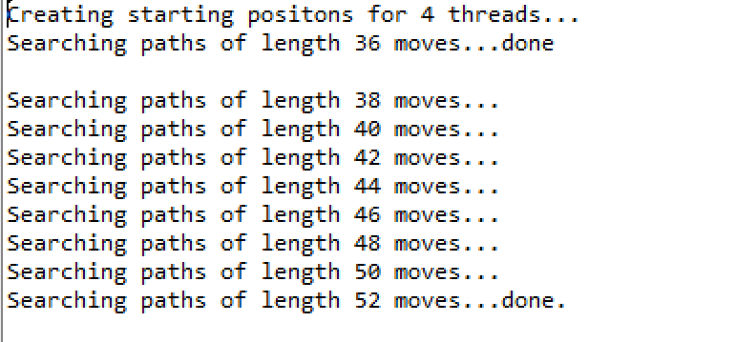
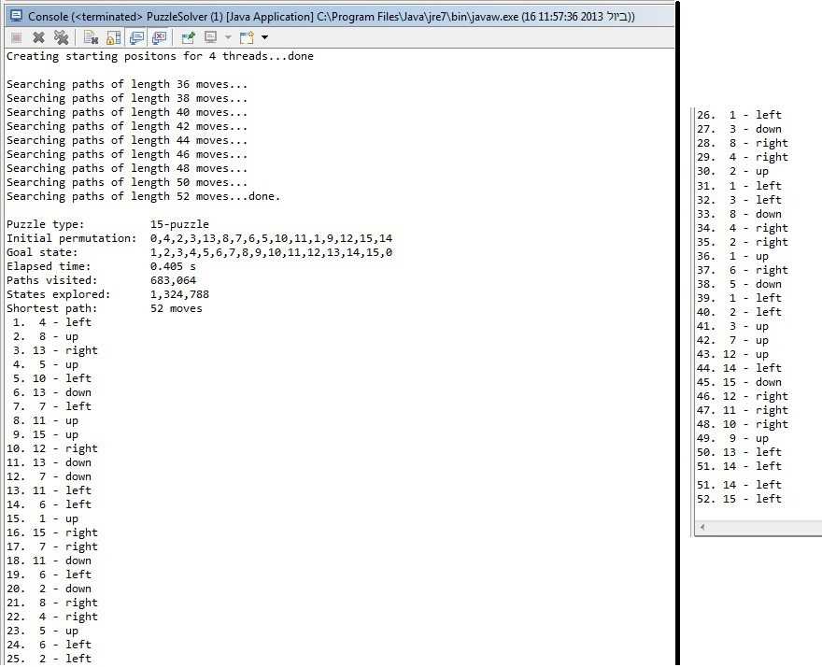
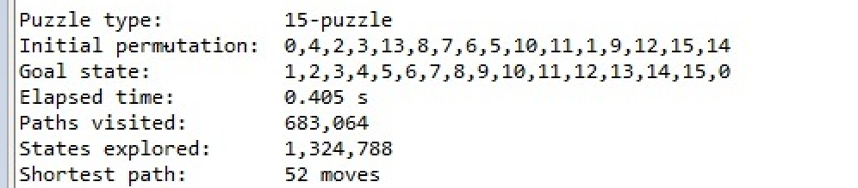
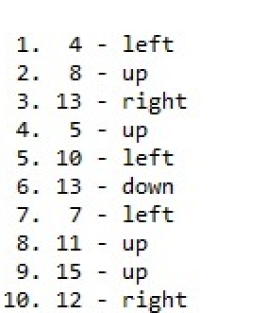

Slide 14

FUTURE DEVELOPMENT
Connectivities to social networks
Implementing more gamification tools

Slide 15

QUESTIONS

Slide 16

Thank you for listening !

